Slide 1

UNSUPERVISED METHODS TO GROUP USERS’ CONSUMPTION BEHAVIOUR TO ENHANCE PERSONALIZE SERVICE DEGRADATION POLICIES
Project Module 1
Roberto Casaluce – Maciej Zuziak

Slide 2

EXPLORATORY DATA ANALYSIS AND FEATURE ENGINEERING

Slide 3
OVERVIEW
ONE DATASET CONTAINING 1249 STATISTICAL UNITS
114 DIFFERENT FEATURES (ONLINE PLATFORMS AND MOBILE APPLICATIONS)
TIME EXPRESSED IN SECOND, DATA CONSUMPTION IN BYTES
TASK IS TO IDENTIFY THE EXISTENCE OF CONSUMER GROUPS

Slide 4
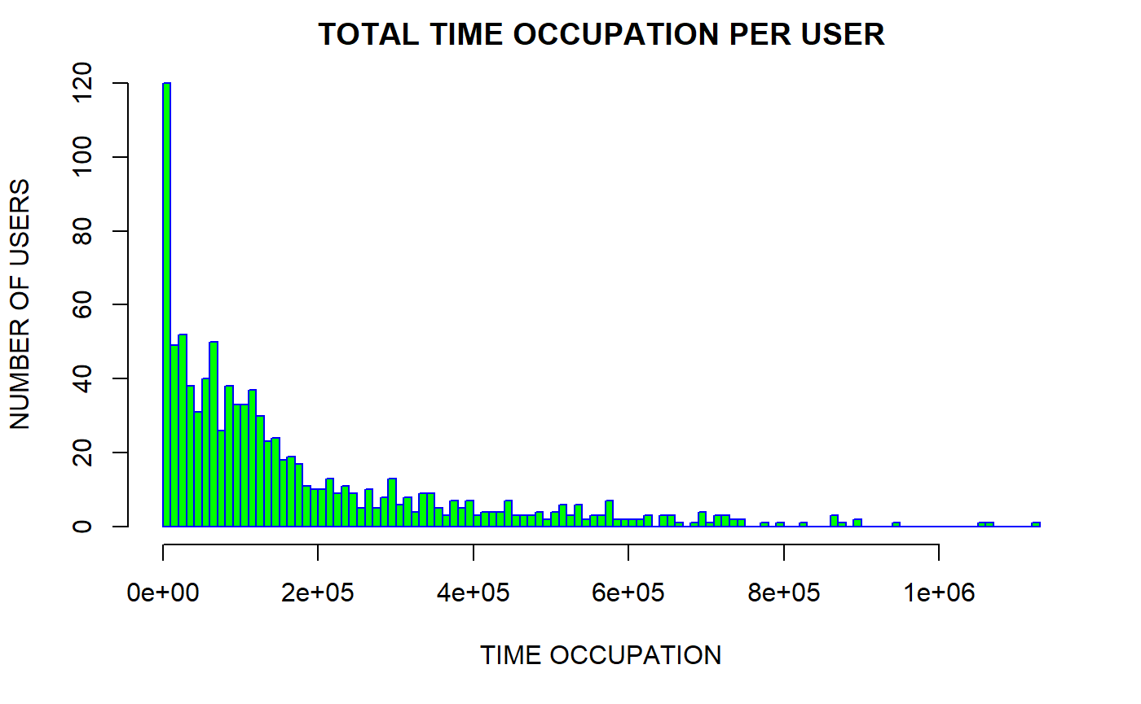

Slide 5
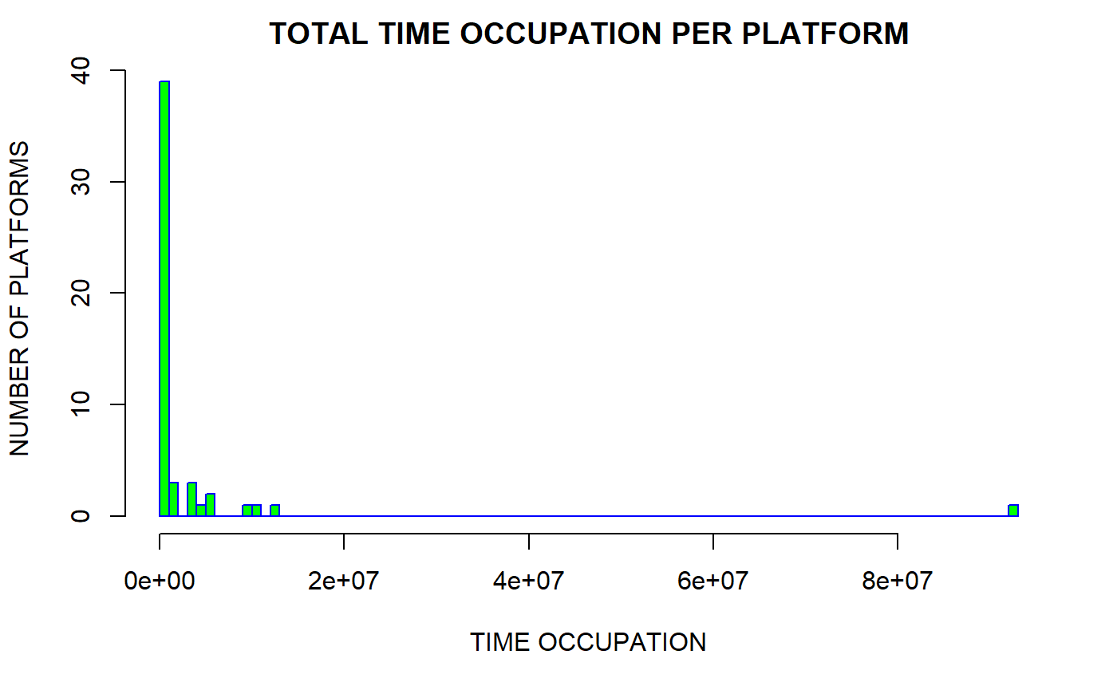

Slide 6
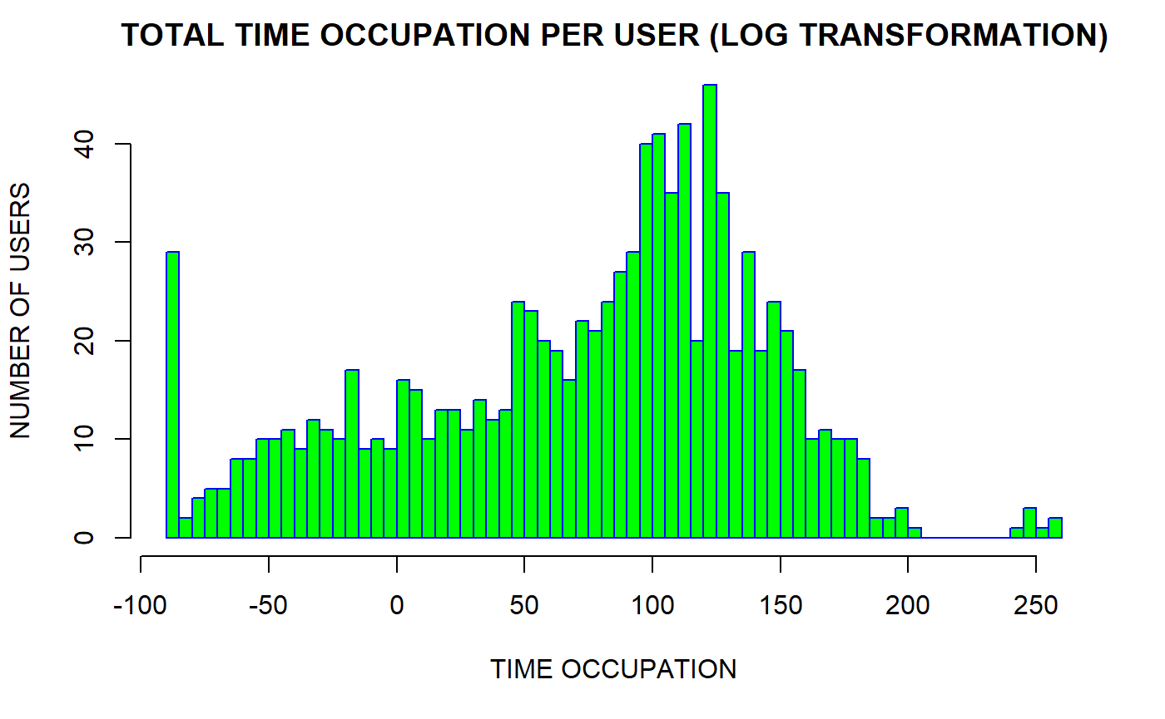

Slide 7
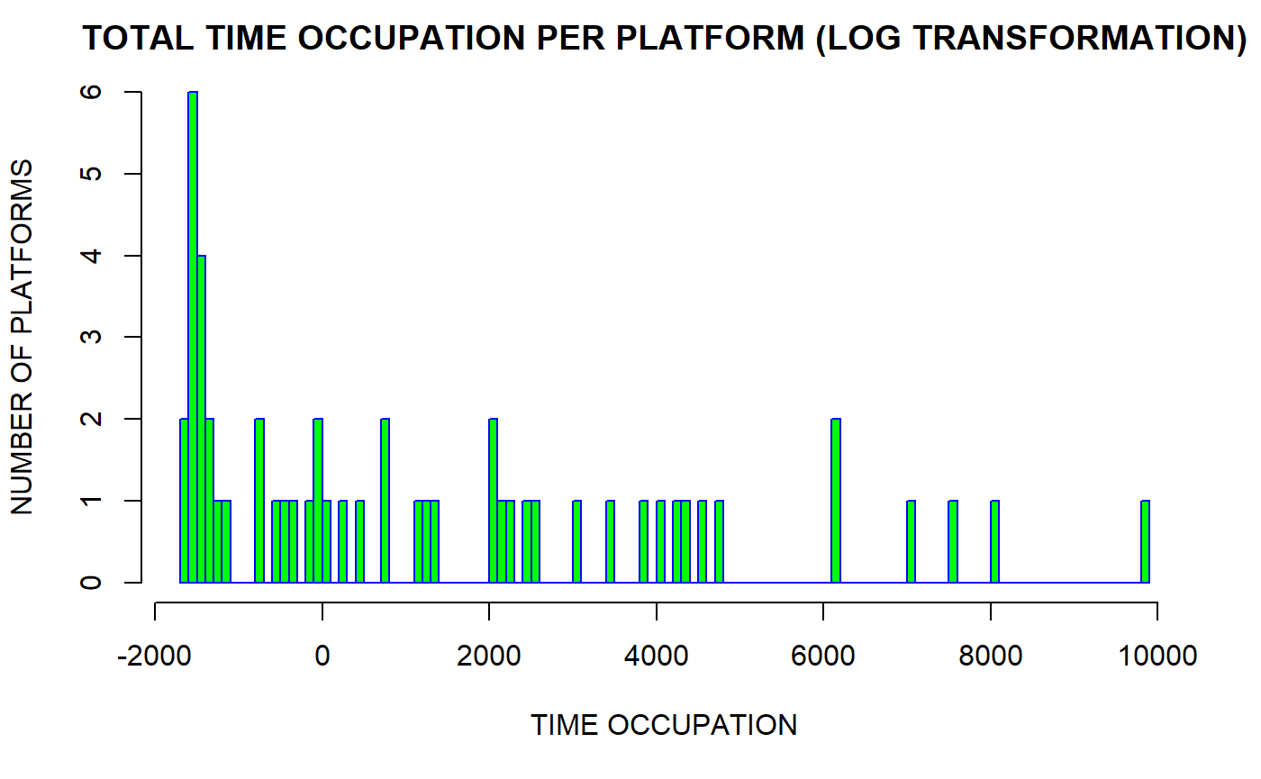

Slide 8
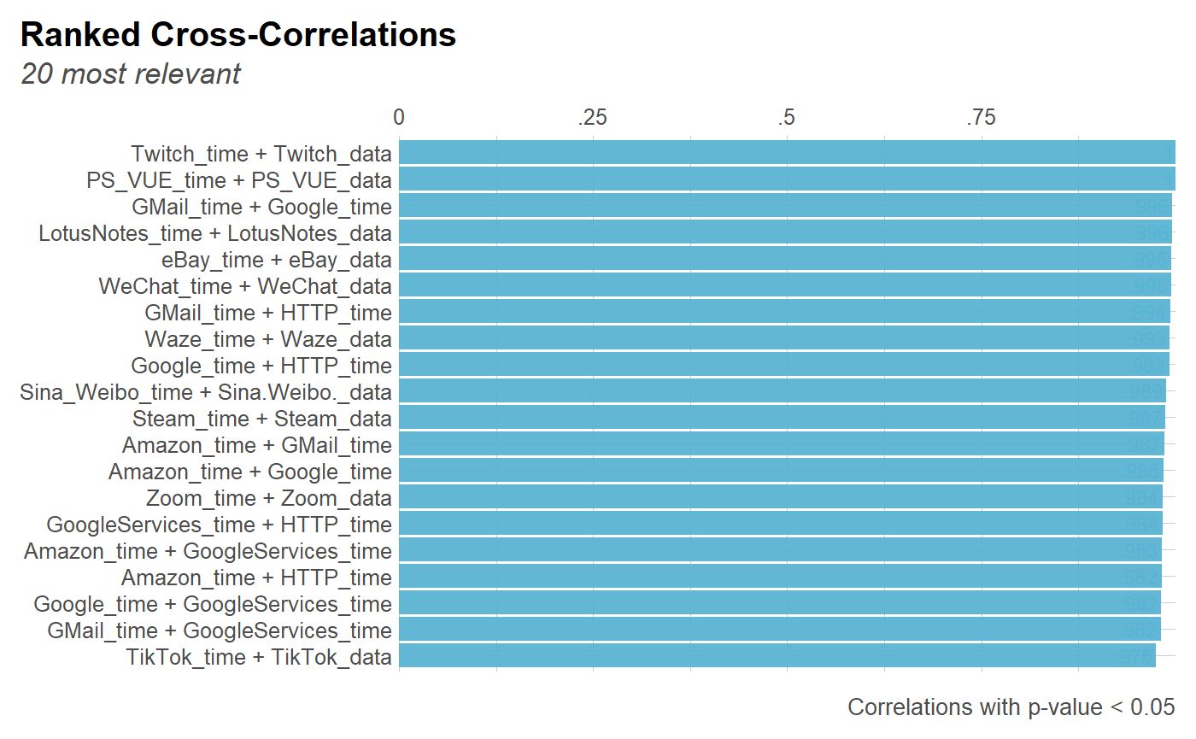

Slide 9
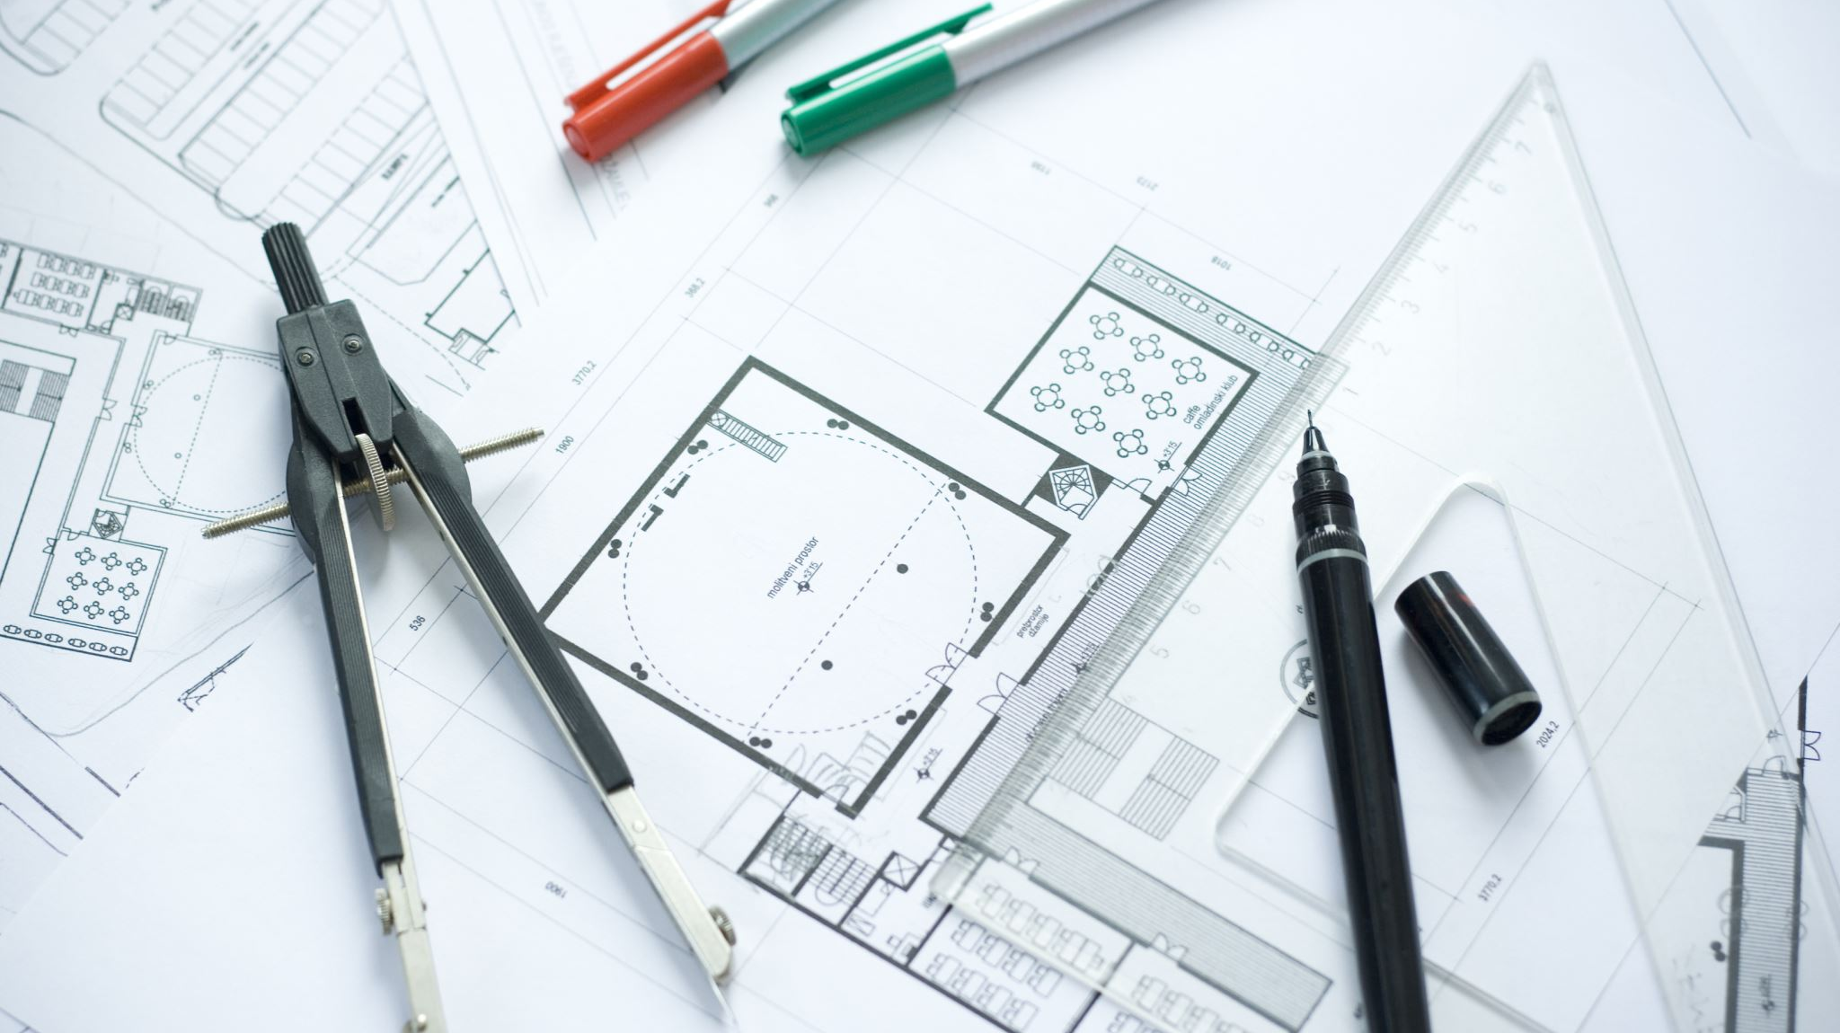
FEATURE ENGINEERING OVERVIEW

Slide 10
WE HAVE…
DELTED FEATURES RELATED TO DATA USAGE
01
DELETED FEATURES THAT CONTAINED LESS THAN TWO USERS’ ENTRIES
02
DELETAED DUPLICATED ENTIRES
03
PERFORMED LOG TRANSOFMORATION DESCRIBED BEFORE $x_{ij}=\ln\left(x_{ij}+N\left(0,1\right)\right)$
PERFORMED LOG TRANSOFMORATION DESCRIBED BEFORE 𝑥_𝑖𝑗=ln⁡(𝑥_𝑖𝑗+𝑁(0,1))
04

Slide 11

DATASET VISUALIZAITON (PCA)

Slide 12
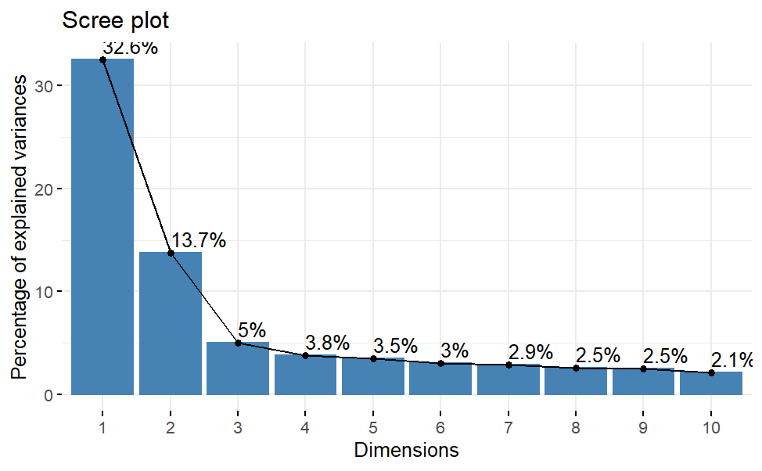
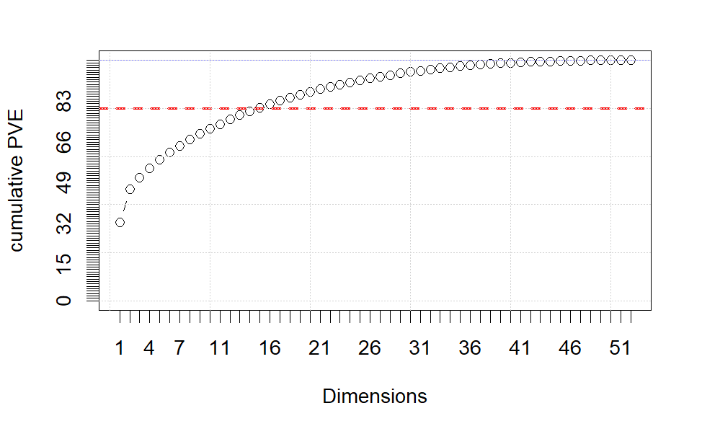
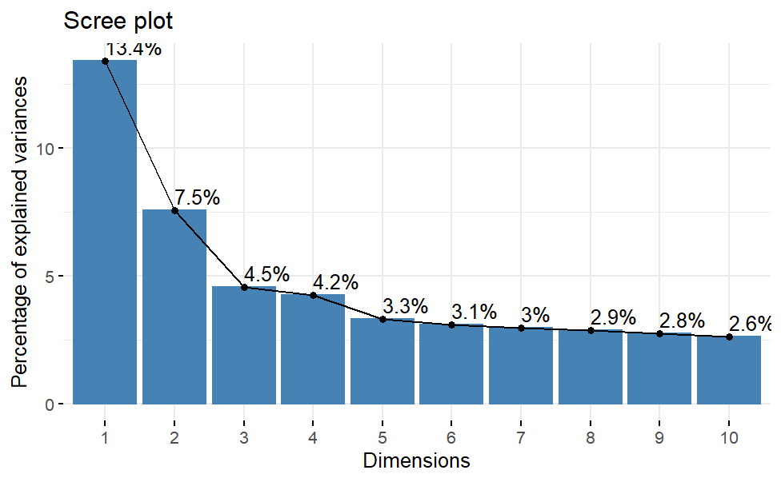
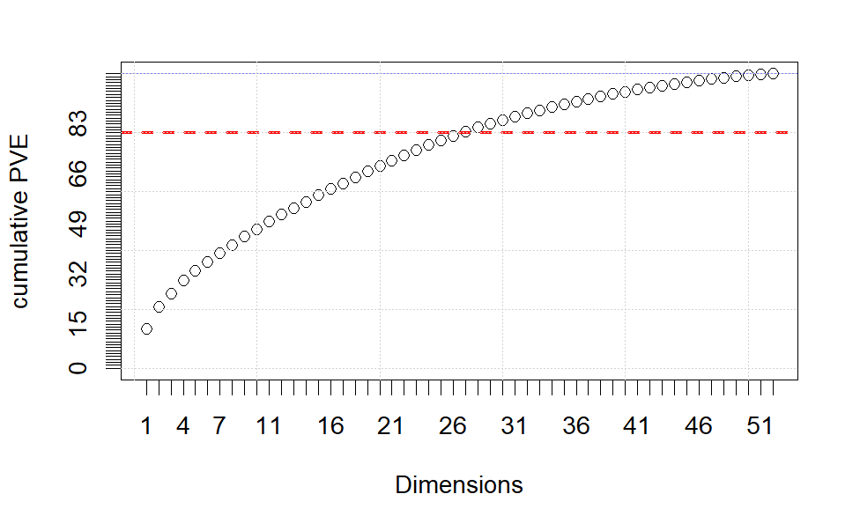
LOG TRANSFORMED DATA
SCALED DATA

Slide 13
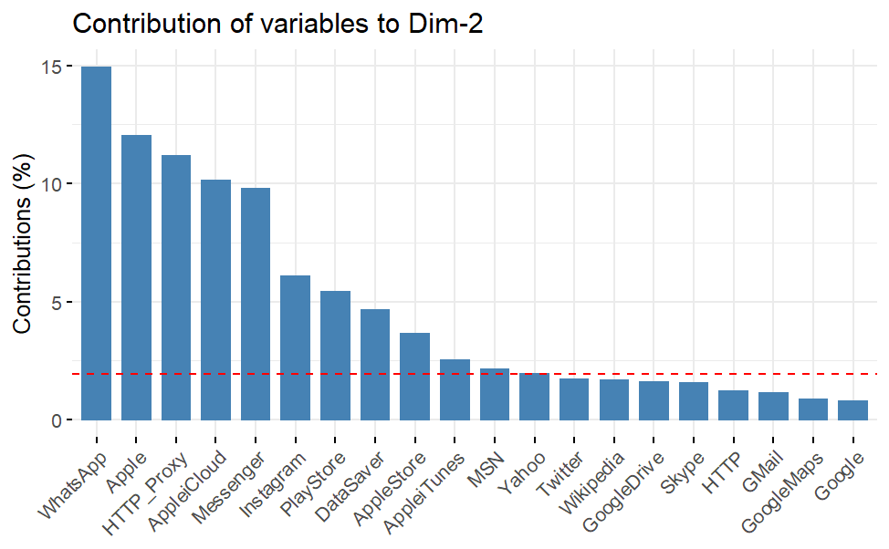
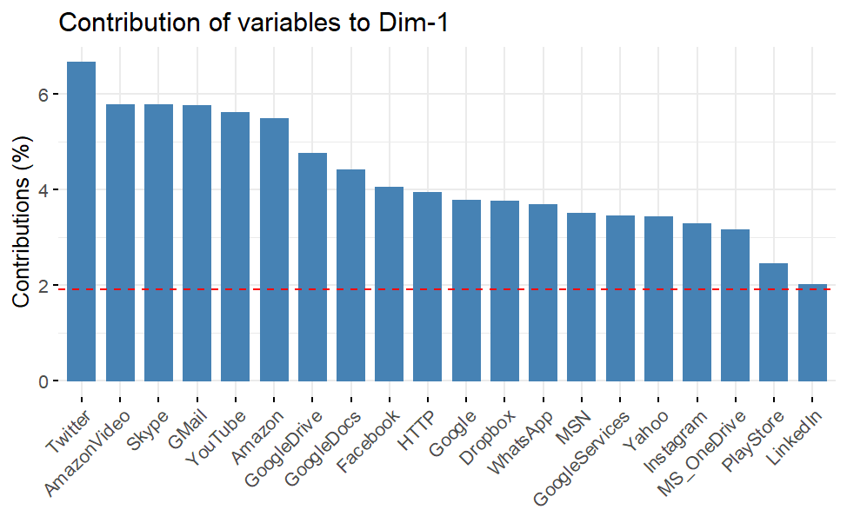
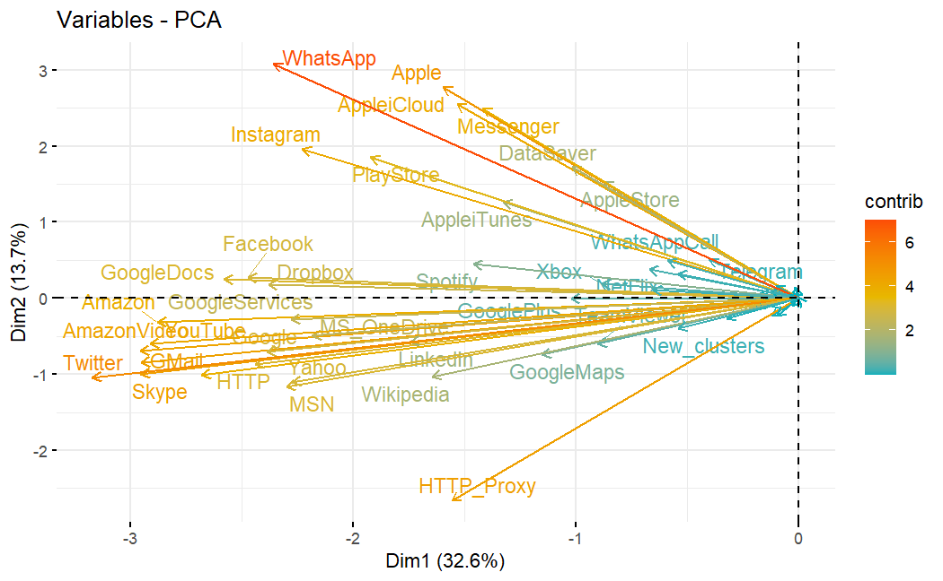

Slide 14
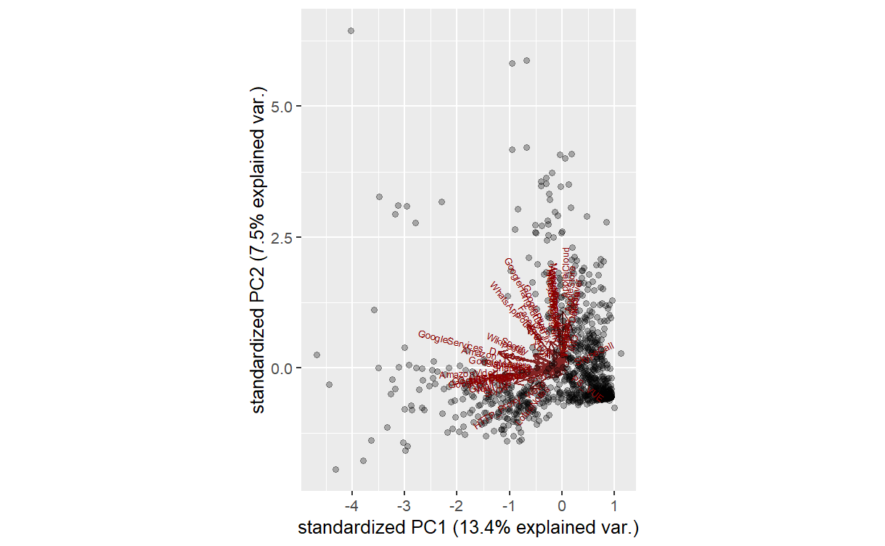
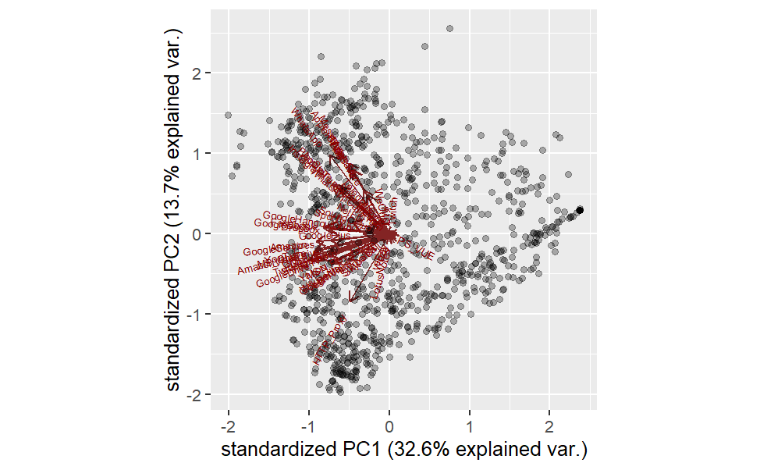
SCALED DATA
LOG TRANSFORMED DATA

Slide 16
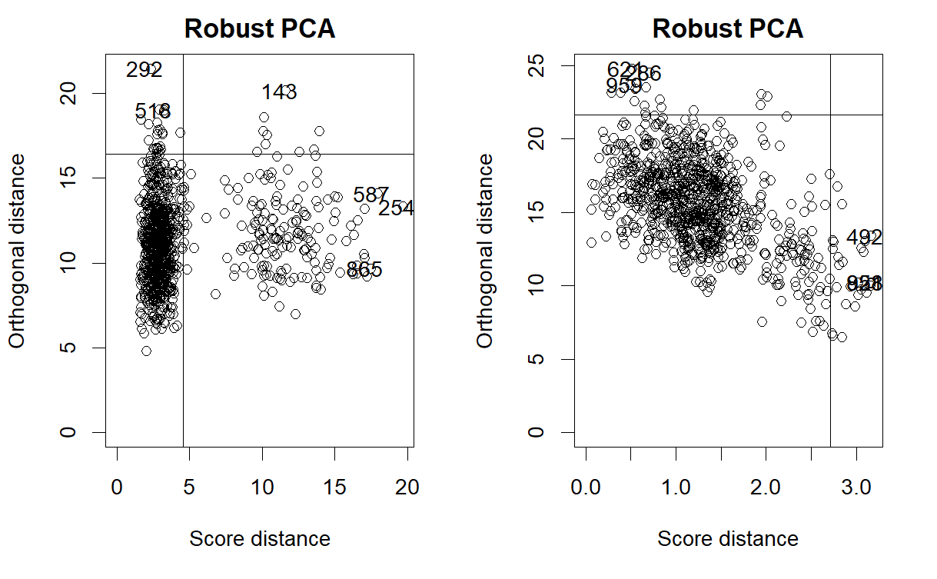
FIRST TWO PRINCIPAL COMPONENTS

Slide 17
ROBUST PCA
FIRST TWO PRINCIPAL COMPONENTS

Slide 18
Bad
leverage
Orthogonal outliners
FIRST TWO PRINCIPAL COMPONENTS
Regular points
Regular points

Slide 19
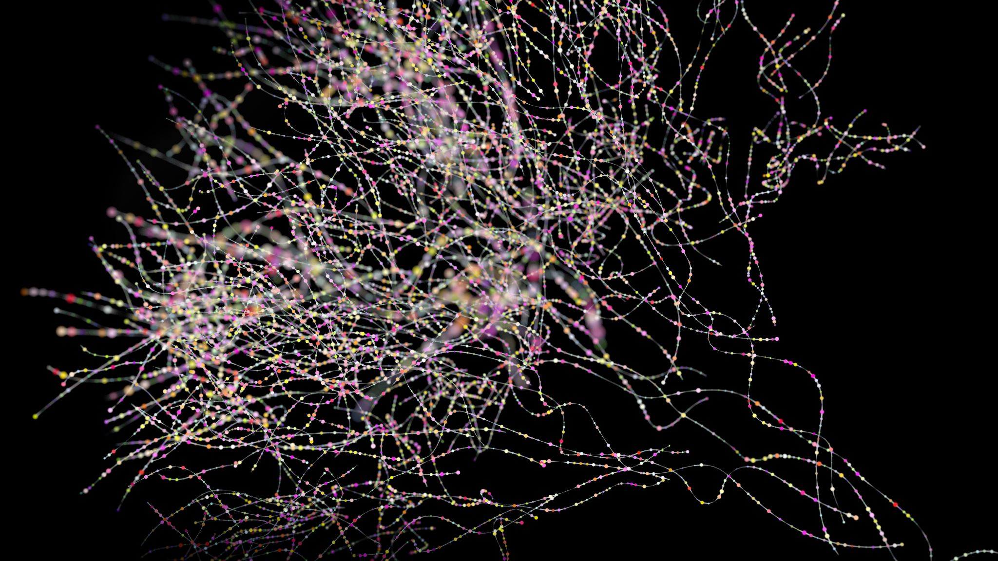
CLUSTERING

Slide 20
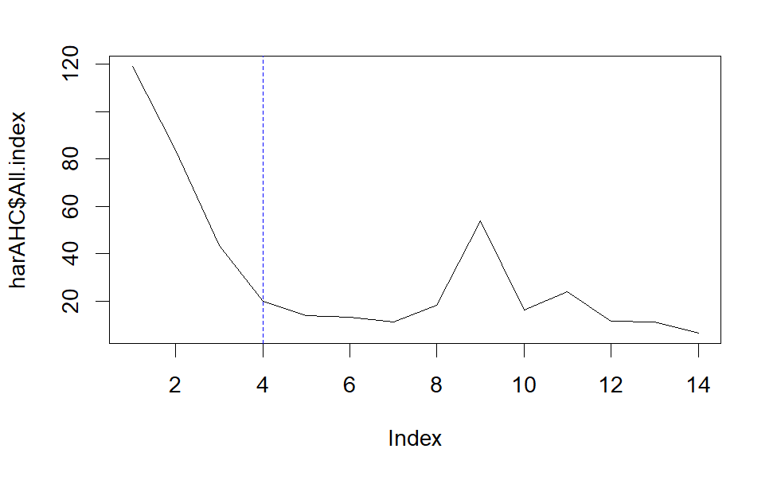
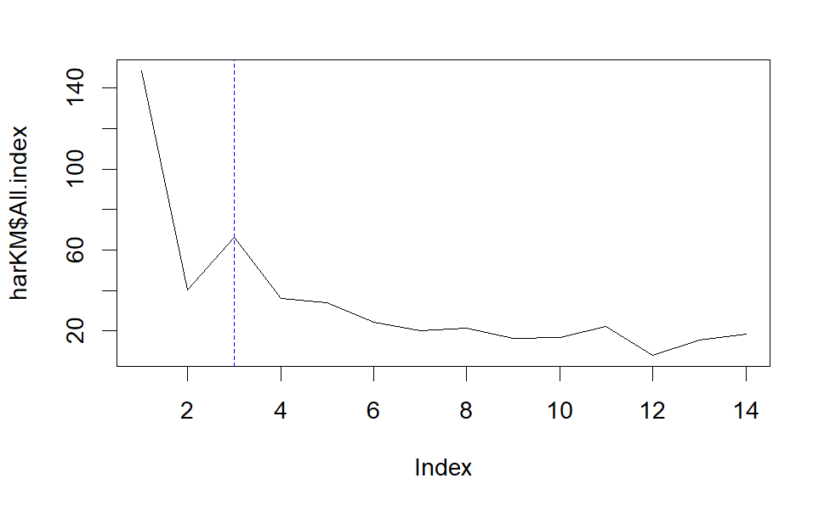
CLUSTERING METHOD SELECTION
Hartigan Index
AGGLOMERATIVE HIERARCHICAL CLUSTERING METHOD
AGGLOMERATIVE HIERARCHICAL CLUSTERING METHOD
From a previous work (Rojas et al., 2020):
3/4 clusters - Low, Medium, High and Very High

Slide 21
EVALUATING CLUSTERING METHODS
APN | 0.015 | kmeans | 3
AD | 23.40 | kmeans | 4
ADM | 0.33 | kmeans | 3
FOM | 2.18 | kmeans | 4
Cluster stability measure::
The average proportion of non-overlap (APN)
The average distance (AD)
The average distance between means (ADM)
The figure of merit (FOM)

Slide 22
Connectivity | 140.92 | hierarchical | 3
Dunn | 0.24 | hierarchical | 3
Silhouette | 0.19 | kmeans | 3
Internal measures for cluster validation

Slide 23
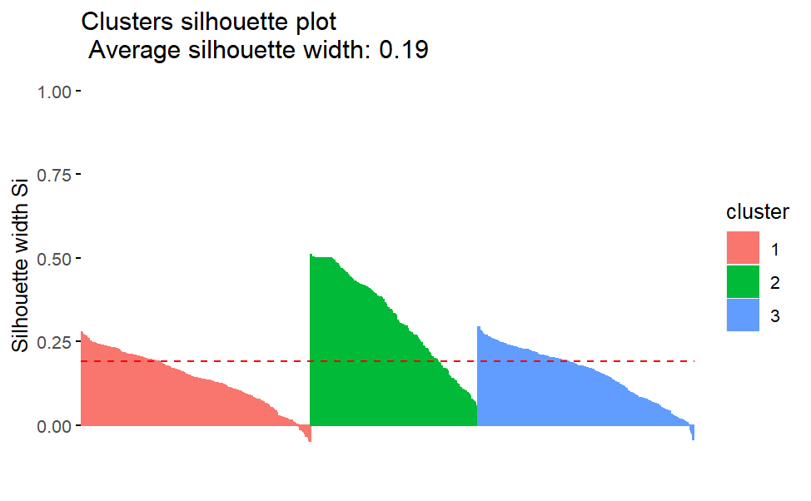
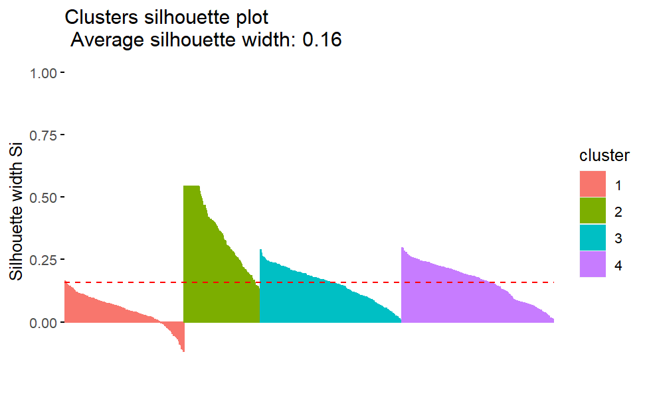
Evaluating a Clustering Solution
Evaluating a Clustering Solution
Silhouette widths kmeans

Slide 24
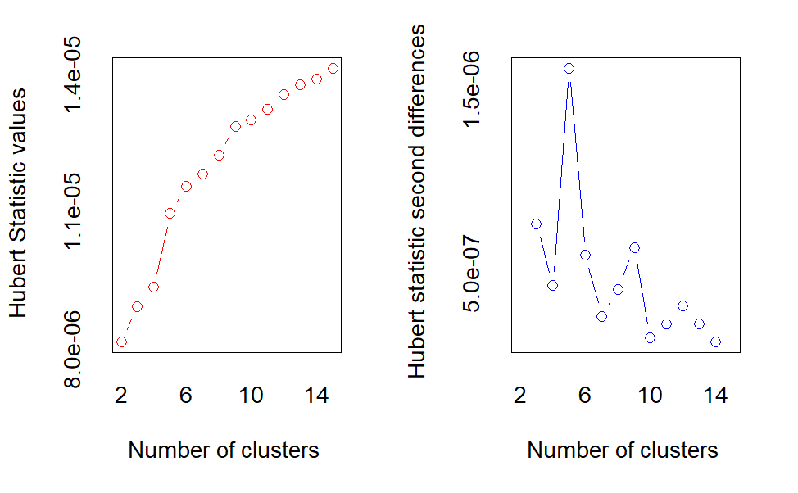
Evaluating a Clustering Solution
Hubert index kmeans
According to the majority rule, the best number of clusters is 3
* 10 proposed 3 as the best number of clusters
* 1 proposed 4 as the best number of clusters

Slide 25
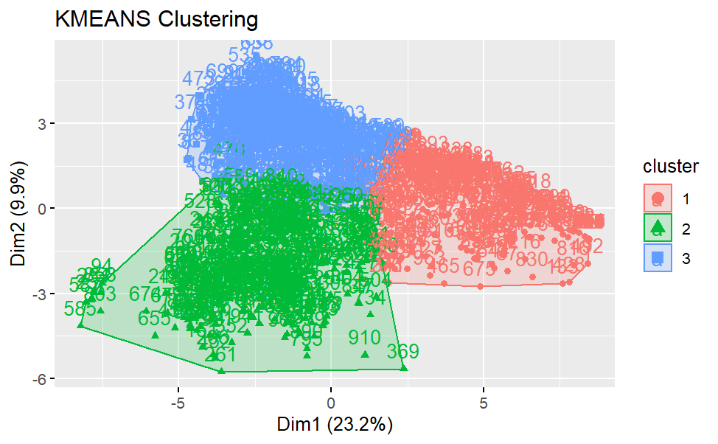
KMEANS 3 CLUSTERS
Size Clusters
1 | 2 | 3
266 | 343 | 364

Slide 26
Reference
Metcalf, L., & Casey, W. (2016). Cybersecurity and applied mathematics. Syngress.
Rojas, J. S., Pekar, A., Rendón, Á., & Corrales, J. C. (2020). Smart user consumption profiling: Incremental learning-based OTT service degradation. IEEE access, 8, 207426-207442.

